Slide 1

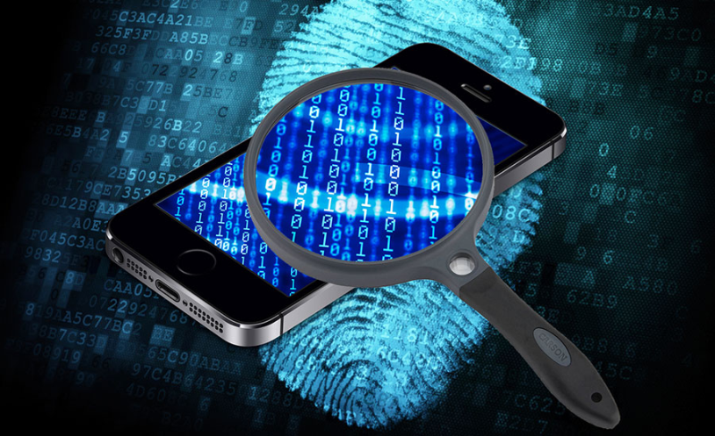
Mobile Phone Security
Dr. Digvijaysinh Rathod
Associate Professor
(Cyber Security and Digital Forensics)
Institute of Forensic Science
Gujarat Forensic Sciences University
digvijay.rathod@gfsu.edu.in

Slide 2
Configuration of Virtual Laboratory for
Mobile Forensic
and
Pen Testing
Dr. Digvijaysinh Rathod

Slide 3
Lab Configuration
a.Configuration of GenY motion in virtual machine
b.Configuration of Santoku OS in virtual machine
c.Configuration of Appie
Dr. Digvijaysinh Rathod

Slide 4
GenY motion
Dr. Digvijaysinh Rathod

Slide 5
GenY motion
a.Configuration of GenY motion in virtual machine
Cross-platform Android emulator for developers & QA engineers. Develop & automate your tests to deliver best quality apps. On desktop, AWS, GCP & SaaS.
GenY motion is a virtual environment that allows you to simulate phones on your computer.
You can create the phone and run apps through it as if you were playing them on a mobile device.
It is used by developers to test their products.
Dr. Digvijaysinh Rathod

Slide 6
GenY motion
a.Configuration of GenY motion in virtual machine
The system includes cloud technology that allows you to check websites and work alongside others.
You can check how the GPS is working or how the WiFi adaptor will react to different settings.
It is compatible with Android SDK and Studio.
This feature means you can build your application in this software and immediately transfer it for testing on GenY motion.
Dr. Digvijaysinh Rathod

Slide 7
GenY motion
a.Configuration of GenY motion in virtual machine
The program also is extremely fast, using x86 architecture.
Configuration Steps of GenY motion in virtual machine
https://www.genymotion.com
Dr. Digvijaysinh Rathod

Slide 8
Santoku
Dr. Digvijaysinh Rathod

Slide 9
Santoku
Santoku Linux flavor and its free and open source
Name was suggested by Thomas Cannon of via Forensics (who happens to be the project leader of Santoku Linux)
Santoku Linux is aimed at
Mobile Forensics,
Mobile Malware Analysis, and
Mobile Security Testing;
List of tools available in the santoku
https://santoku-linux.com/features/
Dr. Digvijaysinh Rathod

Slide 10
Santoku
GNU/Linux distro designed to help you in every aspect of your
mobile forensics,
mobile malware analysis,
reverse engineering and
security testing
Dr. Digvijaysinh Rathod

Slide 11
Santoku
Tools available in the Santoku are:
Development Tools:
Penetration Testing:
Reverse Engineering:
Wireless Analyzers:
Device Forensics:
Mobile Infrastructure:
Dr. Digvijaysinh Rathod

Slide 12
Santoku
If you are into mobile security and mobile forensics then this distribution is definitely right for you.
Mobile Forensics:
Firmware flashing tools for multiple manufacturers
Imaging tools for NAND, media cards, and RAM
Free versions of some commercial forensics tools
Useful scripts and utilities specifically designed for mobile forensics
Dr. Digvijaysinh Rathod

Slide 13
Santoku
Mobile Malware Analysis:
Mobile device emulators
Utilities to simulate network services for dynamic analysis
Decomplication and disassembly tools
Access to malware databases
Dr. Digvijaysinh Rathod

Slide 14
Santoku
Mobile Security Testing
Decomplication and disassembly tools
Scripts to detect common issues in mobile applications
Scripts to automate decrypting binaries, deploying apps, enumerating app details, and more
Configuration Steps of Santoku: https://santoku-linux.com/
Dr. Digvijaysinh Rathod

Slide 15
Appie
Appie – Android Pentesting Portable Integrated Environment
Appie is a software package that has been pre-configured to function as an Android Pentesting Environment on any windows based machine without the need of a Virtual Machine (VM) or dual boot.
https://manifestsecurity.com/appie/
Dr. Digvijaysinh Rathod

